Slide 1


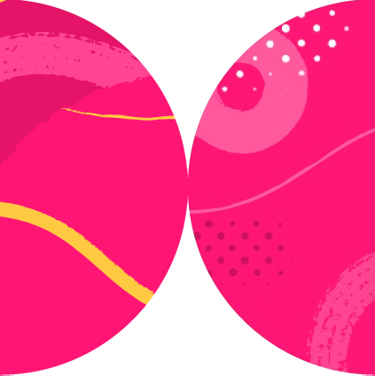

Creating Testable Components

Slide 2


Anatomy of a React Application
Most application code should not depend on React
React components are harder to test
Application logic should not be in React components

Slide 3

Designing Components to Be Testable
{ count: 1 }
p r
o
DOM
p s
onClick()
render()

Slide 4

Barriers to Testability
Global Variables
Context
useEffect Hook
useState Hook

Slide 5



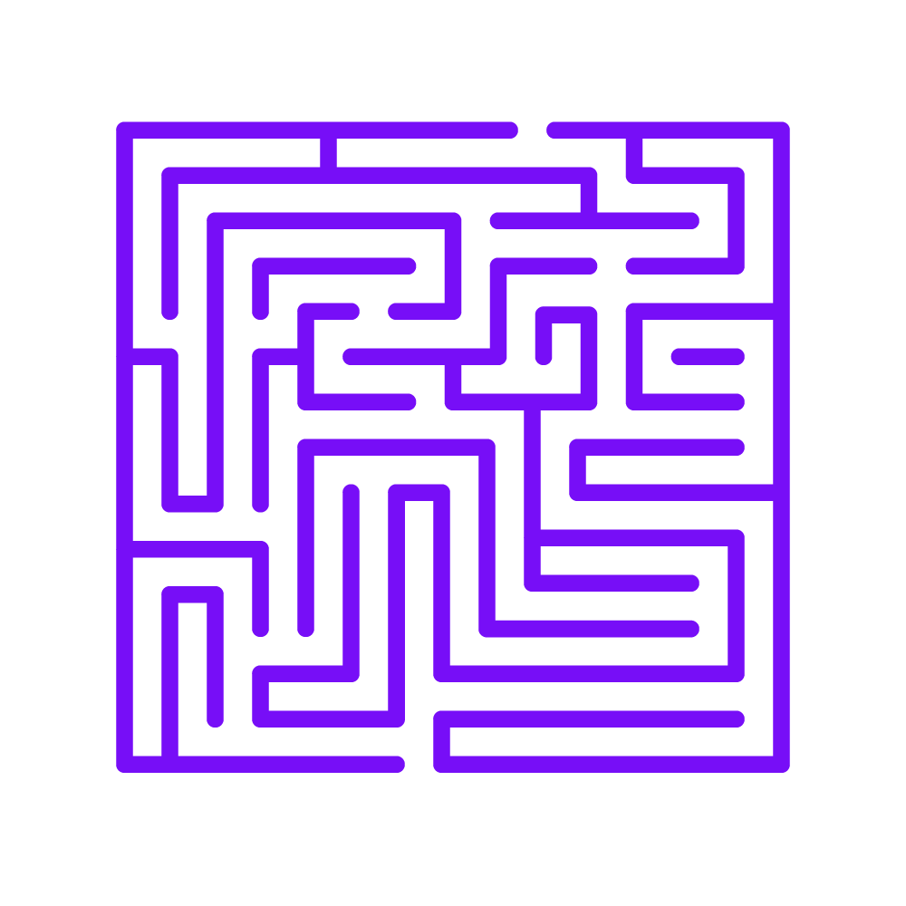



Testing Too Much
Tests not needed
Take time
Add complexity
Slow feedback loop
False negatives
Refactoring friction

Slide 6
Improving Testability

Slide 7
Extract Pure Component
Before.js
After.js
const ParagraphCount = ({count}) => { return <div>
This page contains {count} paragraphs.
</div>;
const ParagraphCounter = () => {
let [paras, setP] = React.useState(0); React.useEffect(()=>{
setP(document.querySelectorAll('p').length);
});
return <ParagraphCount count={paras} />
const ParagraphCounter = () => {
let [paras, setP] = React.useState(0);
React.useEffect(()=>{ setP(document.querySelectorAll('p').length);
});
return <div>
This page contains {paras} paragraphs.
</div>;
};
};
};

Slide 8
Extract Functionality
ParagraphCount.js
const ParagraphCount = ({count}) => { return <div>
This page contains {count} paragraphs.
</div>;
};
const ParagraphCounter = () => {
let [paras, setP] = React.useState(0); React.useEffect(()=>{
setP(document.querySelectorAll('p').length);
});
return <ParagraphCount count={paras} />
};
document_reflection.js
export function countParagraphs() {
return document.querySelectorAll('p').length;
}

Slide 9
Extract Functionality
ParagraphCount.js
document_reflection.js
import { countParagraphs } from './document_reflection';
const ParagraphCount = ({count}) => { return <div>
This page contains {count} paragraphs.
</div>;
};
const ParagraphCounter = () => {
let [paras, setP] = React.useState(0); React.useEffect(()=>{
setP(countParagraphs());
});
return <ParagraphCount count={paras} />
};
export function countParagraphs() {
return document.querySelectorAll('p').length;
}

Slide 10

Summary
Design testable components
Test application logic outside of React components
Use “pure” components

